Slide 1







IOT WORKLOAD CHARACTERIZATION IN NEXT GENERATION CLOUD SYSTEMS UPDATE
Supervised by: Dr. Karan Mitra, Dr. Saguna Saguna,
Dr. Christer Åhlund
Presented by: Fatema Mirza

Slide 2






Latest additions
TABLE OF CONTENTS
fatmir-0@student.ltu.se

Slide 3
01
Latest additions
fatmir-0@student.ltu.se

Slide 4
ARIMA
AR: Autoregression. A model that uses the dependent relationship between an observation and some number of lagged observations.
I: Integrated. The use of differencing of raw observations (e.g. subtracting an observation from an observation at the previous time step) in order to make the time series stationary.
MA: Moving Average. A model that uses the dependency between an observation and a residual error from a moving average model applied to lagged observations.

Slide 5
ARIMA
The parameters of the ARIMA model are defined as follows:
p: The number of lag observations included in the model, also called the lag order.
d: The number of times that the raw observations are differenced, also called the degree of differencing.
q: The size of the moving average window, also called the order of moving average.

Slide 6
ARIMA
Auto Correlation Function (ACF)
The correlation between the observations at the current point in time and the observations at all previous points in time. We can use ACF to determine the optimal number of MA terms or q. The number of terms determines the order of the model.
Partial Auto Correlation Function (PACF)
As the name implies, PACF is a subset of ACF. PACF expresses the correlation between observations made at two points in time while accounting for any influence from other data points. We can use PACF to determine the optimal number of terms to use in the AR model or p. The number of terms determines the order of the model.

Slide 7
ADF
#Ho: It is non-stationary
#H1: It is stationary
We will be considering the null hypothesis that data is not stationary and the alternate hypothesis that data is stationary.

Slide 8
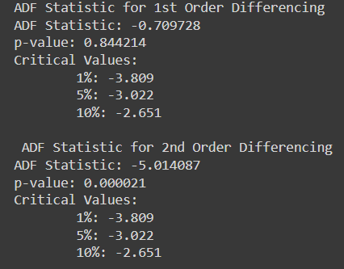
ADF statistics
Here P-value is 0.84 which is greater than 0.05, which means data is accepting the null hypothesis, which means data is non-stationary for 1st order differencing.
Here P-value is 0.000021 which is less than 0.05, which means data is accepting the alternate hypothesis, which means data is stationary for 2nd order differencing.
Hence we can use d order of 2, also confirmed from the graph.
fatmir-0@student.ltu.se 25/02/2022 | 07

Slide 9

ADF, KPSS, PP Test
Augmented Dickey Fuller test (ADF Test) is a common statistical test used to test whether a given Time series is stationary or not.
Kwiatkowski–Phillips–Schmidt–Shin (KPSS) tests are used for testing a null hypothesis that an observable time series is stationary around a deterministic trend (i.e. trend-stationary) against the alternative of a unit root.
Phillips–Perron is a unit root test used in time series analysis to test the null hypothesis that a time series is integrated of order 1.
From the test we can see that the d value is to be 2.
fatmir-0@student.ltu.se 25/02/2022 | 07

Slide 10
All the graphs
There are way too many graphs to fit in the excel. So they have been attached in the email. For hourly, half hourly, fifteen minutes and five minutes, all the months as well as aggregated have analyzed. They are denoted by monthname_i where i: _1 represents acf
_2 represents pacf
_3 represents the ARIMA forecasting
_4 represents the residuals

Slide 11
Result of ARIMA (Might be too small to see, so excel file is attached)
Type | Granularity | ARIMA order | AIC | BIC | HQIC | MAE | RMSE | NRMSE | MAPE
all | Hourly | 1,2,1 | 444.892 | 449.257 | 445.92 | 4661.282 | 10349.76 | 0.92308018 | 0.135276
 | 30 minutes | 1,2,1 | 801.025 | 808.34 | 803.766 | 1301 | 3572 | 0.288 | 0.07
 | 15 minutes | 1,2,1 | 1449.946 | 1460.119 | 1454.055 | 510.673 | 1299.795 | 0.0686 | 0.06
 | 5 minutes | 1,1,1 | 3727.87 | 3742.508 | 3733.736 | 56.95296 | 176.2657 | 0.00033207 | 0.020242
Jan | Hourly
Feb | Hourly | 1,2,1 | 292.063 | 296.428 | 293.091 | 184.7435 | 233.8252 | 1.91661416 | 0.360182
 | 30 minutes | 1,2,1 | 565 | 569 | 567 | 137.3476 | 170.0583 | 0.44012348 | 0.587357
 | 15 minutes | 1,2,1 | 1006 | 1017 | 1011 | 20.77816 | 26.01061 | 0.06375712 | 0.181926
 | 5 minutes | 1,1,1 | 2568 | 2586 | 2575 | 12.22638 | 15.92301 | 0.04026021 | 0.394533
March | Hourly | 1,2,1 | 303.403 | 307.768 | 304.432 | 153.8301 | 204.2091 | 14.1639115 | 0.303347
 | 30 minutes | 1,2,1 | 573 | 580 | 575 | 27.09156 | 37.75233 | 0.15022296 | 0.106533
 | 15 minutes | 1,2,1 | 1004 | 1014 | 1008 | 10.98902 | 14.95762 | 0.00862286 | 0.086311
 | 5 minutes | 1,1,1 | 2453 | 2471 | 2460 | 5.668601 | 7.769136 | 0.00462806 | 0.13973
Apr | Hourly | 1,2,1 | 307.844 | 312.208 | 308.872 | 164.3153 | 224.3527 | 35.7818666 | 0.363426
 | 30 minutes | 1,2,1 | 575 | 583 | 578 | 24.47663 | 35.36184 | 0.24458443 | 0.10767
 | 15 minutes | 1,2,1 | 1009 | 1019 | 1013 | 13.34187 | 17.8147 | 0.04189746 | 0.115924
 | 5 minutes | 1,1,1 | 2543 | 2561 | 2550 | 10.21298 | 13.51674 | 0.00709491 | 0.297355
May | Hourly | 1,2,1 | 301 | 305 | 302 | 135.2819 | 178.4413 | 15.5833349 | 0.281698
 | 30 minutes | 1,2,1 | 549 | 556 | 551 | 13.64165 | 27.4579 | 0.14130748 | 0.05805
 | 15 minutes | 1,2,1 | 1012 | 1022 | 1016 | 16.45535 | 21.6456 | 0.01764943 | 0.143056
 | 5 minutes | 1,1,1 | 2492 | 2511 | 2500 | 8.6125 | 11.10753 | 0.00891369 | 0.217448
June | Hourly | 1,2,1 | 323 | 327 | 324 | 241.4988 | 309.7241 | 0.49536908 | 0.322785
 | 30 minutes | 1,2,1 | 585 | 593 | 588 | 24.15968 | 38.9142 | 0.0801826 | 0.074558
 | 15 minutes | 1,2,1 | 1093 | 1097 | 1095 | 17.49684 | 21.64679 | 0.01964943 | 0.001431
 | 5 minutes | 1,1,1 | 2648 | 2666 | 2655 | 9.37765 | 12.7748 | 0.00039301 | 0.19431
July | Hourly | 1,2,1 | 317 | 322 | 318 | 235.6169 | 296.4502 | 4.62129727 | 0.282155
 | 30 minutes | 1,2,1 | 573 | 581 | 576 | 12.86811 | 42.05846 | 0.00373714 | 0.038173
 | 15 minutes | 1,2,1 | 1062 | 1072 | 1066 | 19.55714 | 27.05228 | 0.01324021 | 0.114972
 | 5 minutes | 1,1,1 | 2669 | 2687 | 2676 | 11.21035 | 15.21909 | 0.012851 | 0.186113
Aug | Hourly | 1,2,1 | 245 | 249 | 246 | 43.91418 | 56.9114 | 4.43243412 | 0.462486
 | 30 minutes | 1,2,1 | 450 | 458 | 453 | 11.08072 | 15.60905 | 0.66555615 | 0.244232
 | 15 minutes | 1,2,1 | 1047 | 1058 | 1051 | 20.47476 | 31.32475 | 0.00471402 | 0.101844
 | 5 minutes | 1,1,1 | 2669 | 2687 | 2676 | 11.21035 | 15.21909 | 0.00012851 | 0.086113
Sept | Hourly | 1,2,1
Nov | Hourly | 1,2,1 | 315 | 320 | 317 | 172.257 | 233.6545 | 0.77954811 | 0.239367
 | 30 minutes | 1,2,1 | 581 | 588 | 584 | 7.648508 | 43.3246 | 0.00012665 | 0.024976
 | 15 minutes | 1,2,1 | 1029 | 1043 | 1034 | 60.57305 | 75.89379 | 0.03375873 | 0.361609
 | 5 minutes | 1,1,1 | 2637 | 2655 | 2644 | 11.94129 | 16.50641 | 0.00029876 | 0.232727
Dec | Hourly | 1,2,1 | 310 | 314 | 311 | 170.8228 | 226.6116 | 0.17700672 | 0.229347
 | 30 minutes | 1,2,1 | 561 | 568 | 563 | 8.122513 | 43.48591 | 0.0003345 | 0.026255
 | 15 minutes | 1,2,1 | 1044 | 1056 | 1049 | 70.84874 | 91.16333 | 0.04391158 | 0.415223
 | 5 minutes | 1,1,1 | 2661 | 2680 | 2669 | 12.25581 | 16.36508 | 0.00462529 | 0.234679
Need to fill in September and January as the proper consistent apartment could not be located

Slide 12
The summary of papers to find the dataset
The next 2 slides will show the table where papers have been analyzed to find the dataset as well as the metrics for load balancing. Due to lack of time (as it took forever for windows update), it could not be presented beautifully. I took a screenshot from the thesis report itself. The references for the paper are also copied from the thesis report.

Slide 13
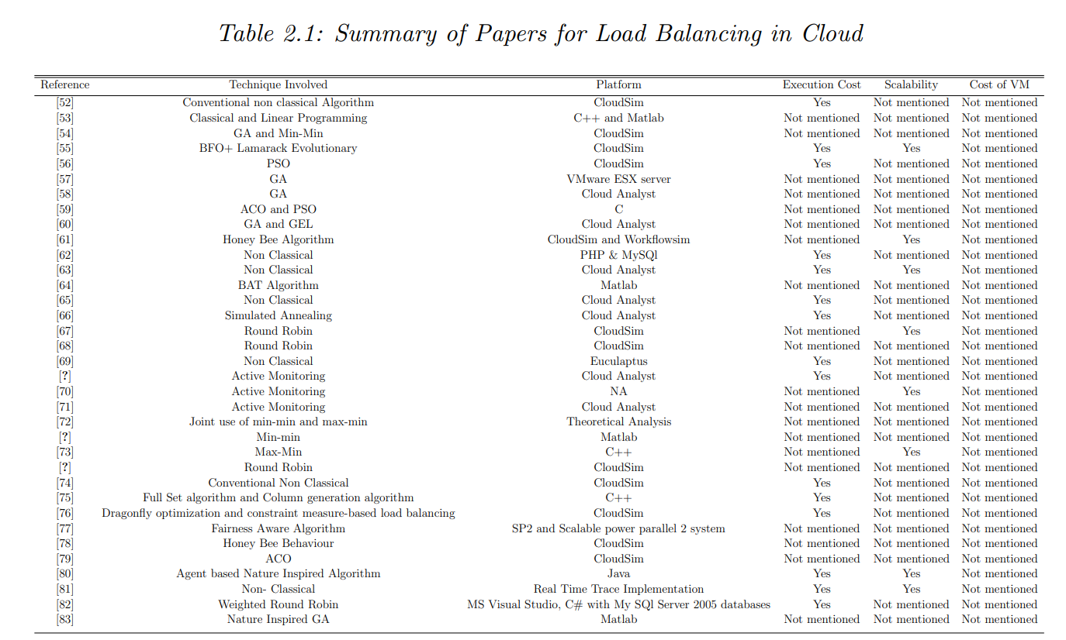

Slide 14
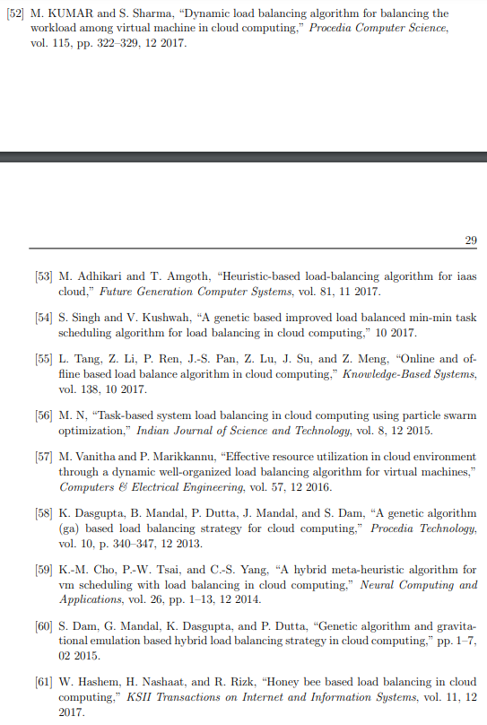
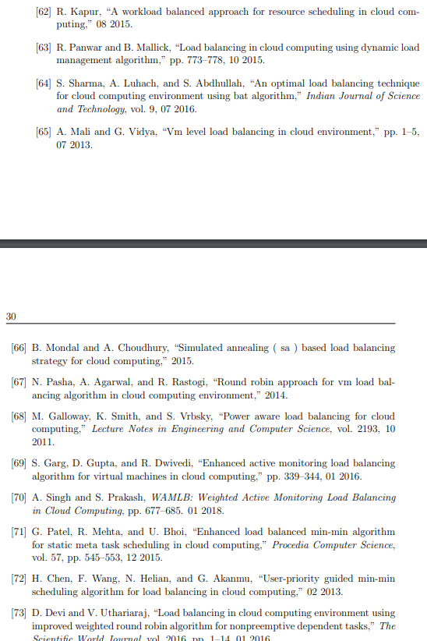
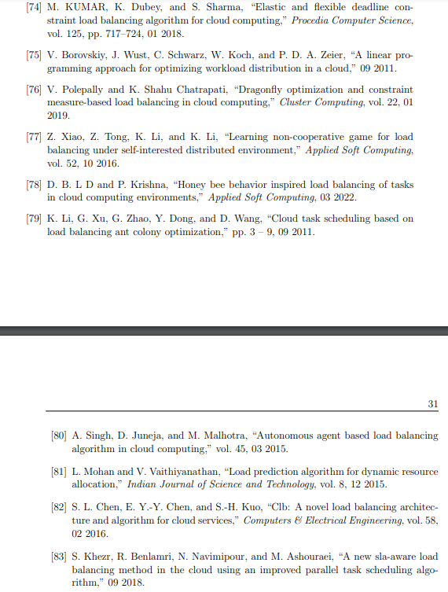

Slide 15
The types of metrics used
Load Balancing is judged on a few QoS (Quality of Service) metrics:
Throughput
2. Response Time
3. Execution cost
4. Scalability
5. Makespan
6. Fault tolerance
7. Migration time
8. Green factors
9. Resource utilization
10. Service time
11.Cost of VM
Highlighted ones might be considered for our thesis – still under research

Slide 16

PROBLEM OF ARIMA ONLY
There are some areas where UNDERPROVISIONING occurs.

Slide 17
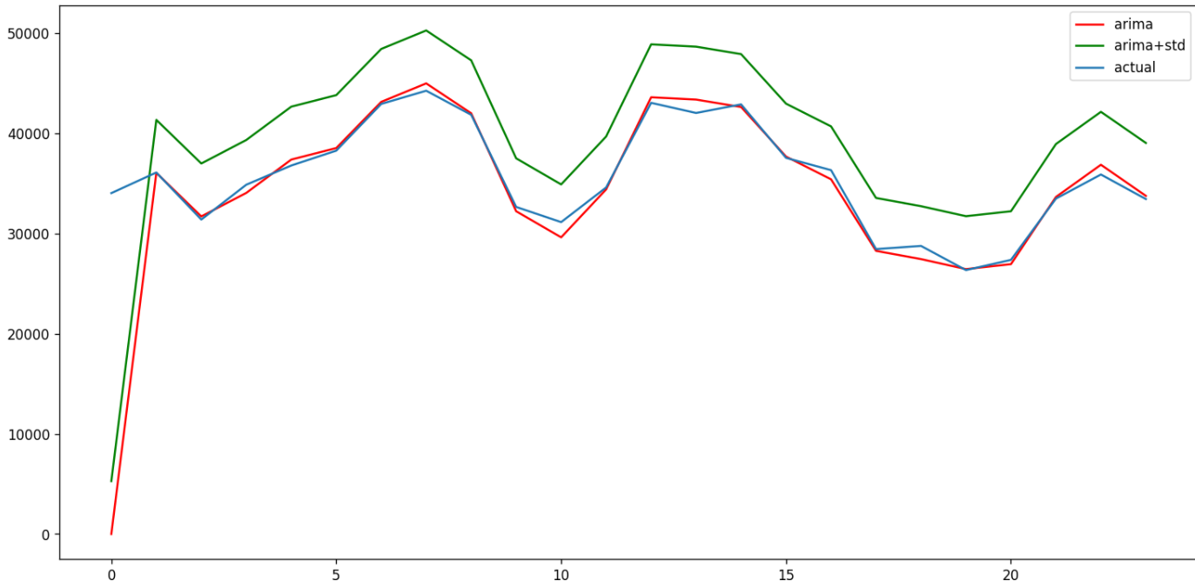
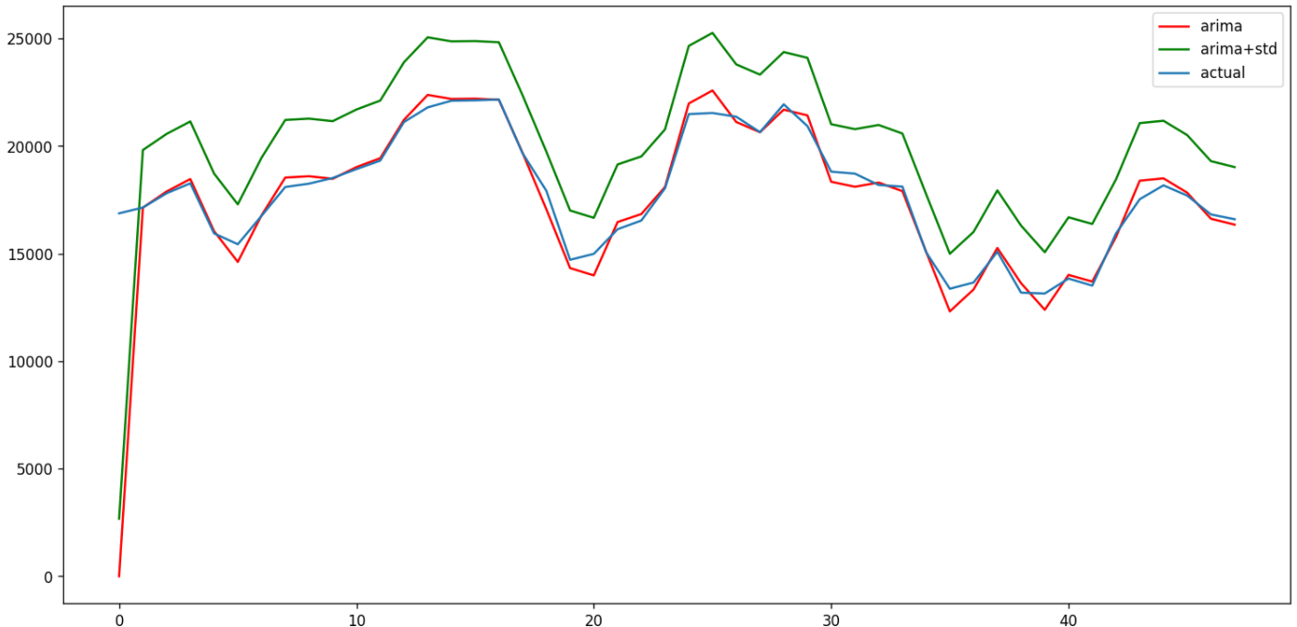
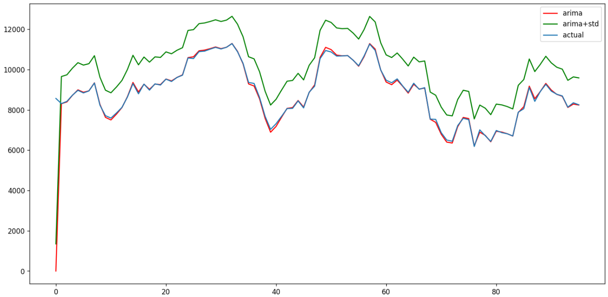
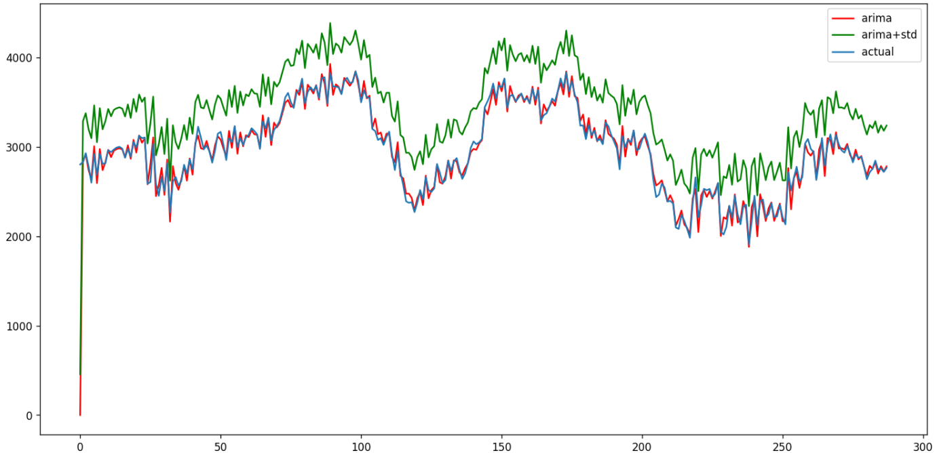
The SOLUTION
Add standard deviation with the ARIMA results

Slide 18
PROBLEM OF ARIMA WITH STD. DEV
Underprovisioning problem is solved, however, too much resources are provisioned!

Slide 19
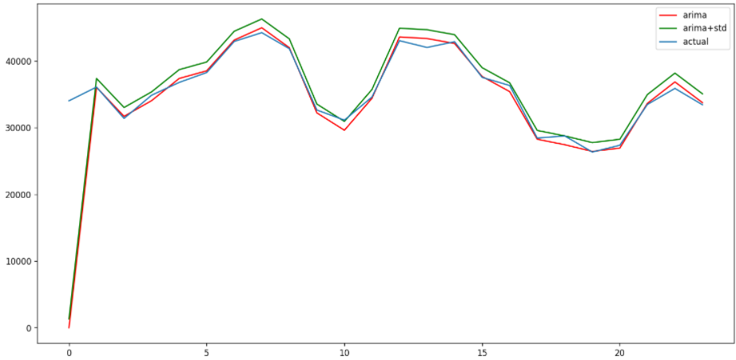
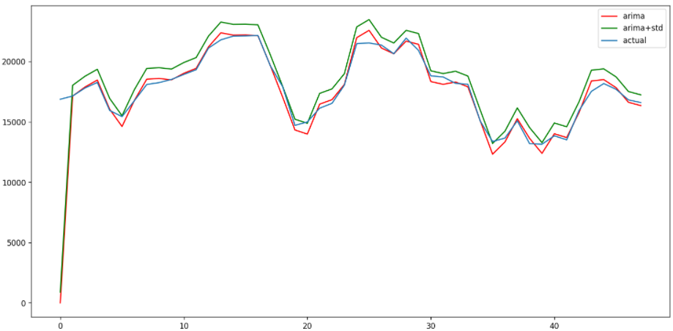
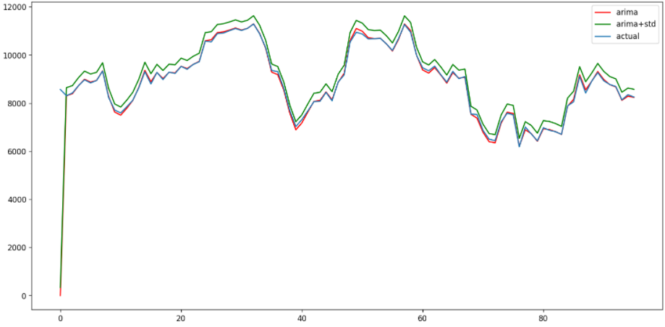
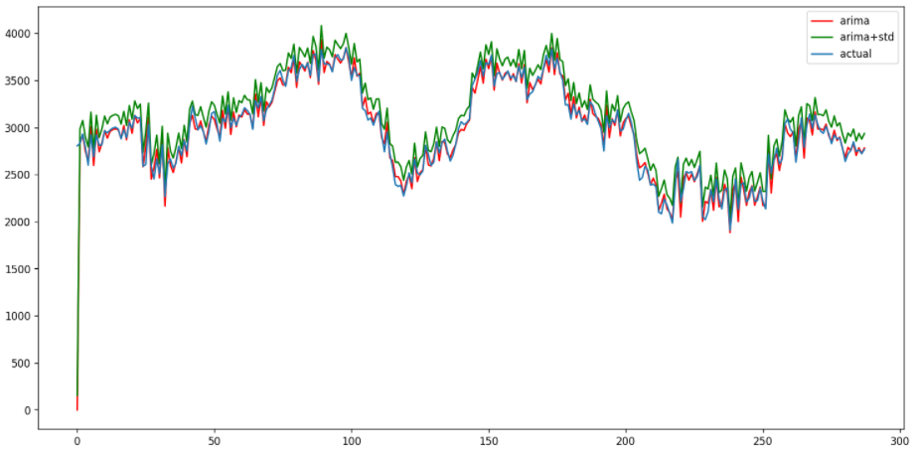
The SOLUTION
Add a division factor of standard deviation with the ARIMA results

Slide 20

Target for next week
Urgently perform the Jmeter!

Slide 21

Thank you! Tack så mycket
Any Questions?
fatmir-0@student.ltu.se

